Slide 1
C-STORE OFFICE
ADVANCED ACCOUNTING – Accounting Reports (Basic)

Slide 2
Agenda
How to find the Accounting reports
Brief overview of each report:
Accounting Profit & Loss
Balance Sheet
Cash Reconciliation Consolidated
General Journal
Intercompany Transfers
Operating Profit Estimates (Profit &Loss)
Statement of Cash Flow
Trail Balance

Slide 3
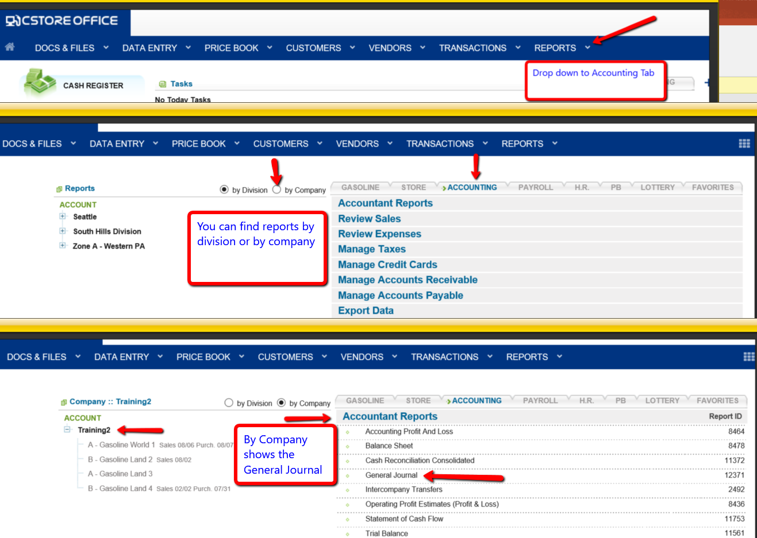

Slide 4
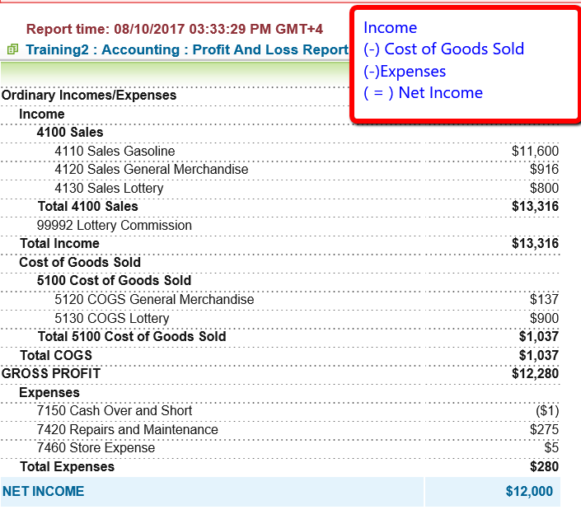
ACCOUNTING PROFIT & LOSS REPORT
A profit and loss statement (P&L) is a financial statement that summarizes the revenues, costs and expenses incurred during a specific period of time, usually a fiscal quarter or year. These records provide information about a company's ability – or lack thereof – to generate profit by increasing revenue, reducing costs, or both

Slide 5
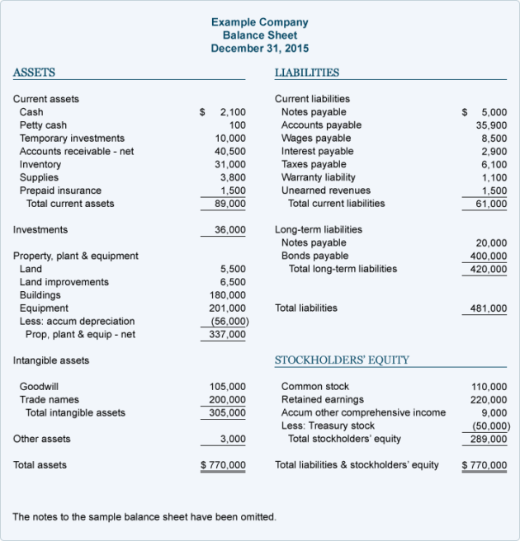
The balance sheet provides information on what the company owns (its assets), what it owes (its liabilities) and the value of the business to its stockholders (the shareholders' equity) as of a specific date. It's called a balance sheet because the two sides balance out. This makes sense: a company has to pay for all the things it has (assets) by either borrowing money (liabilities) or getting it from shareholders (shareholders' equity).

Slide 6
This report is combining all of the current stations under one company and totaling their specific categories

Slide 7
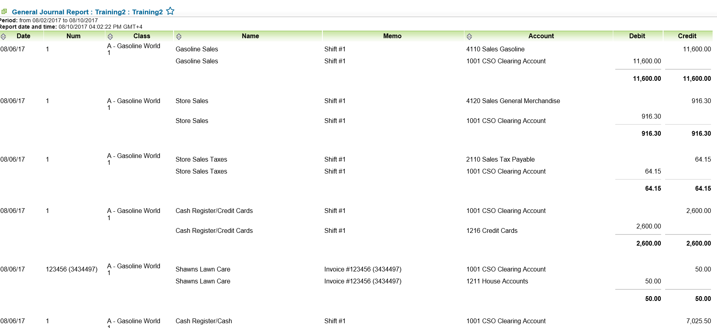
The journal is where double entry bookkeeping entries are recorded by debiting one or more accounts and crediting another one or more accounts with the same total amount. The total amount debited and the total amount credited should always be equal, thereby ensuring the accounting equation is maintained. In accounting and bookkeeping, a journal is a record of financial transactions in order by date

Slide 8
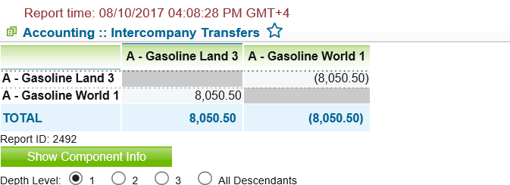
INTERCOMPANY TRANSFERS
This report keeps track of money movements between stations under the same company

Slide 9
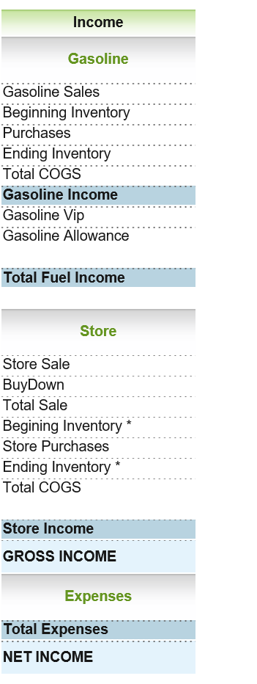
OPERATING PROFIT ESTIMATES (PROFIT & LOSS)
Operating profit is the profit earned from a firm's normal core business operations. This value does not include any profit earned from the firm's investments, such as earnings from firms in which the company has partial interest, and the before the deductions of applicable interest and taxes owed.
Operating profit is calculated using the following formula: Operating Profit = Operating Revenue - COGS - Operating Expenses - Depreciation and Amortization

Slide 10
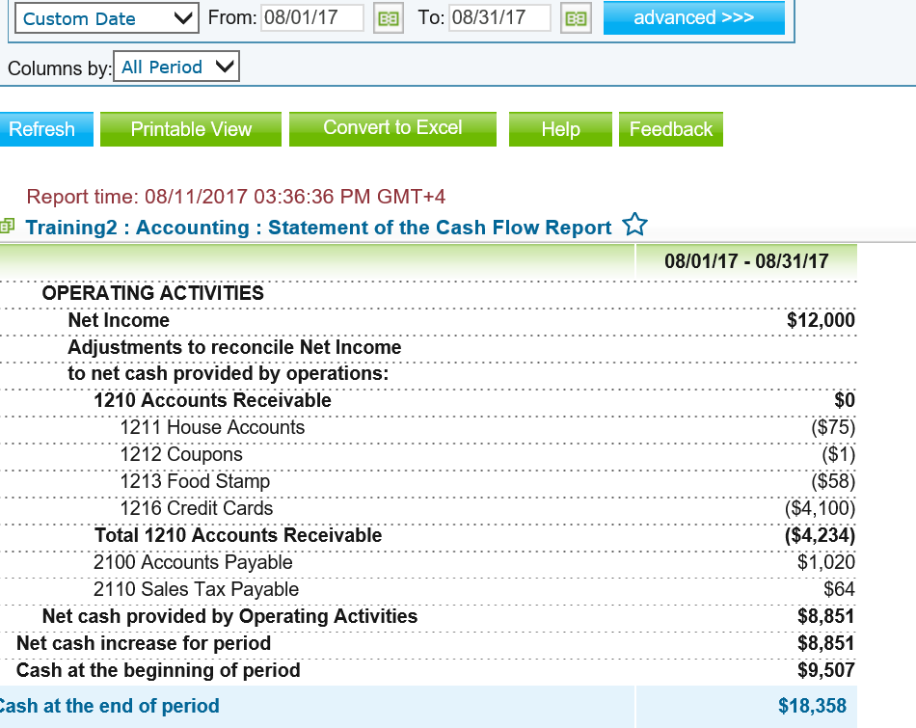
STATEMENT OF CASH FLOW
Complementing the balance sheet and income statement, the cash flow statement (CFS) - a mandatory part of a company's financial reports since 1987 - records the amount of cash and cash equivalents entering and leaving a company. The CFS allows investors to understand how a company's operations are running, where its money is coming from, and how it is being spent

Slide 11
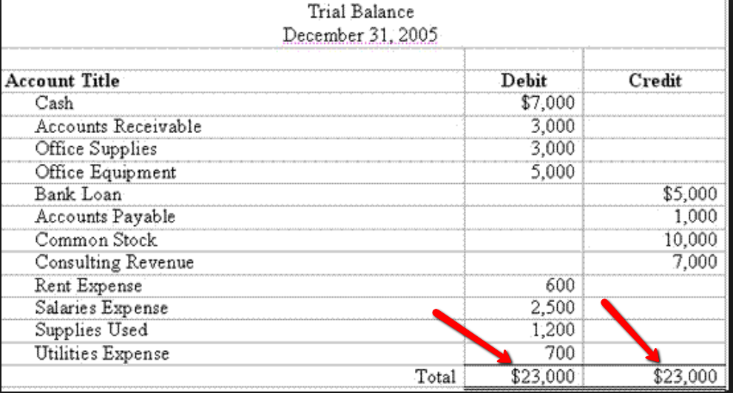
TRIAL BALANCE
A trial balance is a bookkeeping or accounting report that lists the balances in each of an organization's general ledger accounts. (Accounts with zero balances will likely be omitted.) The debit balance amounts are listed in a column with the heading "Debit balances" and the credit balance amounts are listed in another column with the heading "Credit balances." **The total of each of these two columns should be identical.

Slide 12
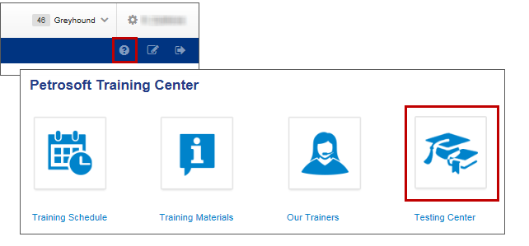
TRAINING CENTER
For additional testing on what you have learned, please refer to our new “Testing Center”.
To access this new feature, click the help icon, and then select Testing Center.
For additional information, please refer to the Accounting Reports section at Petrosoft Cloud Help. Go to C-Store Office > Reports > Accounting Reports.

Slide 13
THANK YOU FOR YOUR TIME!
Get in Touch
www.cstoreoffice.com
Petrosoft LLC
290 Bilmar Drive
Pittsburgh, PA 15205
1.412.306.0640

